Slide 1
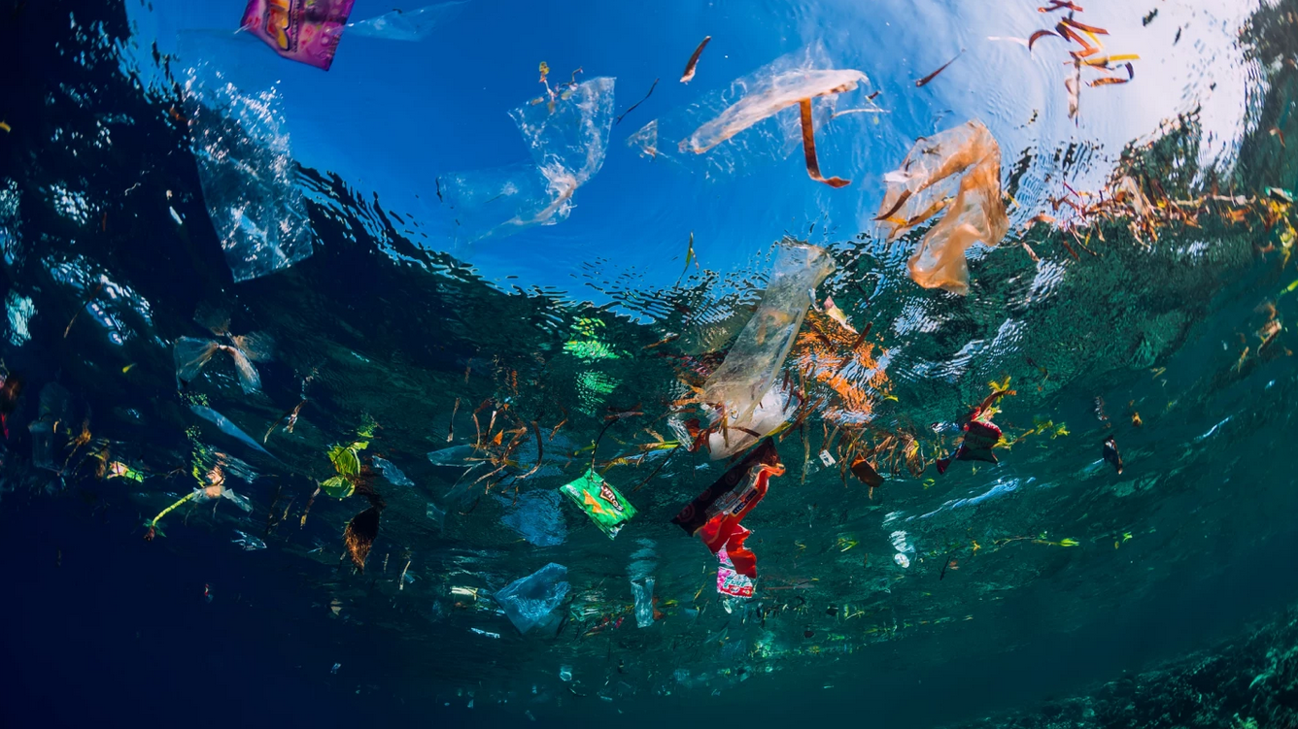
The Toxic Effects of Microplastic and Nanoplastic Bioaccumulation in Aquatic Species
Ravel Larose – University of Connecticut – ravel.larose@uconn.edu
Picture Citation: “Underwater ocean with plastic – Stock editorial photography.” depositphotos 2018. Accessed from https://depositphotos.com/312360394/stock-photo-august-28-2018-bali-indonesia.html

Slide 2
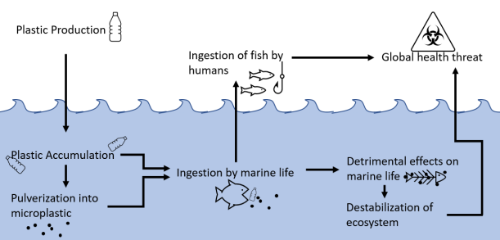
Overview
Microplastic accumulation leads to negative health effects
Six species of aquatic life are exposed to plastic
Results show some consistent trends of toxicity among species exposed to microplastics
The effects of microplastic toxicity appear to depend on the concentration the species are exposed to
A potential maximum safety limit is proposed

Slide 3
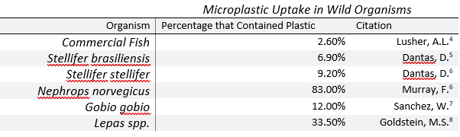
Introduction: What is the Problem?
Plastic sees near universal use & does not biodegrade
Remains in oceans and waterways, becoming microplastics and nanoplastics
Easily ingested by aquatic life
Table 1. Percentages of individual organisms containing plastic somewhere in the body.
Studies show that many fish already consume plastic or microplastic in the wild
No recent studies have shown an uptake percentage of 0%
Microplastics tend to gather other pollutants to their surfaces that increase their toxicity
Toxic microplastics are already present in the environment and getting consumed by fish, and what it is unclear what it does to them.

Slide 4
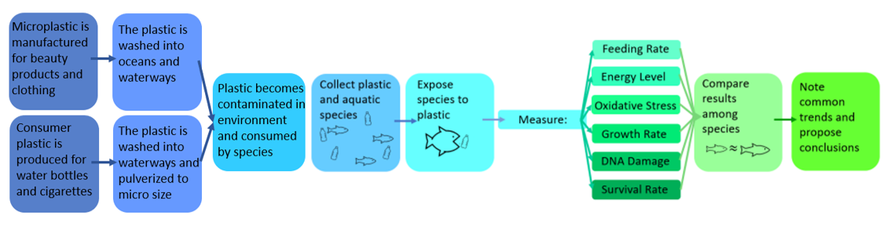
Introduction: How to Solve the Problem
Scheme 1. Scheme showing plastic accumulation in waterways and the flow of the project
Expose various aquatic species to microplastic to find common effects
Note change with microplastic concentration
Suggest a potential safety threshold for microplastic concentration
Studying how plastic affects aquatic life can help to study potential cures to symptoms

Slide 5
Experimental: Materials and Methods
Each species underwent roughly the same experimental procedure: collection and preparation, exposure to microplastic, and collection of results
Three Main Areas of Interest: The effects of microplastic toxicity, the dependence of the effects on the concentration of microplastics, and the effects of contaminated microplastics
Toxicity Effects: D. rerio
D. rerio (zebrafish) embryos were exposed to polystyrene nanoplastics at varying concentrations in egg medium.
Larvae were observed to quantify behavioural changes, and imaged with fluorescent molecules to measure plastic uptake.

Slide 6
Experimental: Materials and Methods
Concentration Dependence: E. sinensis, D. rerio, D. magna
E. sinensis (Chinese river crabs) were exposed to varying concentrations of virgin polystyrene microbeads in water.
They were monitored for oxidative damage in the liver, and change in weight.
M. galloprovincialis (marine mussels) were exposed to polyethylene and polystyrene microbeads contaminated with pyrene.
Pyrene retention was measures via extraction with potassium hydroxide and microplastic retention was measured by staining with dyes.
Pyrene appeared to cause health issues that virgin plastic did not.
D. magna (plankton) were exposed to polystyrene nanoplastics of varying concentrations in water.
Fluorescently labelled nanoparticles were used to determine plastic accumulation, and survival rate was quantified.

Slide 7
Experimental: Materials and Methods
Plastic Contamination: O. latipes, P. viridis
O. latipes (Japanese rice fish) were fed a diet of 10% virgin or contaminated microplastic pellets, which were prepared by soaking in ocean water.
Reference genes and spectrophotometry were used to quantify stress levels and oxidative damage in the liver.
P. viridis (green mussels) were exposed to varying concentrations of PVC microplastics, either virgin or exposed to sea water to absorb pollutants.
Respiration rate was monitored via dissolved oxygen levels in the water, and death rate was also monitored.

Slide 8
Experimental: Present Analysis
All values for concentration of microplastic were converted to ppm in order for effective comparison.
Similar health effects of species were compared at roughly the same plastic concentrations whenever possible
Common health effects were noted
Inconsistency between studies means that similar data sets are not available for all creatures, at all concentrations of microplastic, for every health effect
Trends are drawn from the most commonly tested health effects, and many were shown to depend on the concentration and contamination of the microplastic.

Slide 9
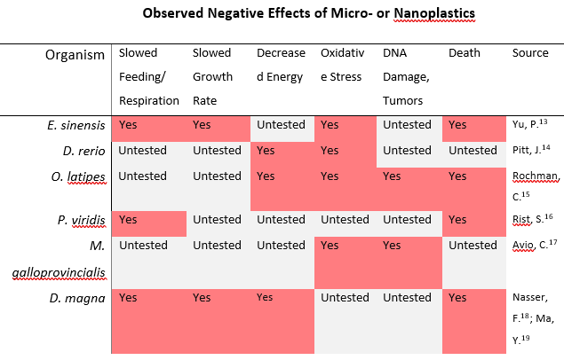
Results: Negative Effects of Microplastic
Table 1. Overview of the negative effects of microplastic consumption on studies species.
Most common effects include slowed feeding, oxidative stress, and death
Some of the species may exhibit more than the noted number of negative effects
A range of common effects are noted, and other species may exhibit more than are shown.

Slide 10
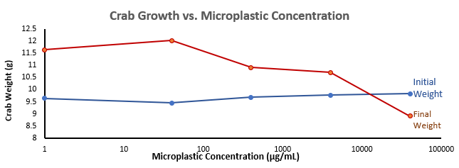
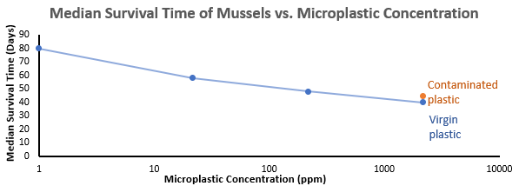
Results: Effective Dependence on Microplastic Concentration
Figure 1. Initial and final weights of E. sinensis exposed to varying concentrations of microplastic.
Downward trend in crab growth as microplastic concentration increases
Downward trend in survival time as microplastic concentration increases
Both symptoms of microplastic poisoning increase in severity as microplastic concentrations increase
Figure 2. Median survival time of M. galloprovincialis exposed to varying concentrations of microplastic.
Increasing microplastic exposure increases the severity of the health effects.

Slide 11
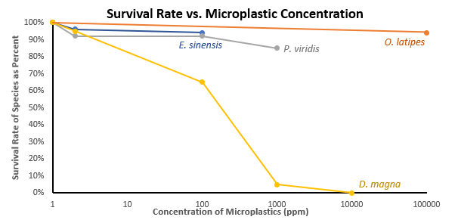
Results: Effective Dependence on Microplastic Concentration
Figure 3. Survival rate of E. sinensis, O. latipes, P. viridis, and D. magna.
Every species shows a lowered survival rate as microplastic concentration increases
The species D. magna shows the most extreme change
Data was not available for every concentration and every species
Survival rate also depends on microplastic exposure, with smaller creatures being impacted much more severely.

Slide 12
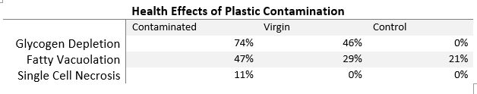
Results: Plastic Contamination
Table 3. Health effects in O. latipes of contaminated and virgin microplastic exposure compared to a control group.
The health effects of plastic contaminated with other pollutants are worse than clean plastics, which are in turn worse than the control
The pollutants appear to cause some health issues that plastic does not
Pollutants include polybrominated diphenyls, polychlorinated biphenyls, and polycyclic aromatic hydrocarbons
Contaminated plastic causes health issues and worsens existing ones.

Slide 13
Discussion: Negative Effects of Microplastic on Aquatic Life
Table 1. Overview of the negative effects of microplastic consumption on studies species.
The most common effects noted are slowed feeding, decreased energy, oxidative stress and death.
Some of these effects may be causally linked, for example slowed feeding and slowed growth
Microplastics may have the same effect on similar creatures
The most common effects confirmed in the studies may extend to all aquatic species, or even all exposed species.

Slide 14
Discussion: Effective Dependence on Microplastic Concentration
Figure 1. Initial and final weights of crabs exposed to varying concentrations of microplastic.
The severity of the health effects worsens with increasing concentration, further confirming that the health effects are caused by microplastic consumption.
Figure 2. Median survival time of mussels exposed to varying concentrations of microplastic.
Confluence of evidence further suggests that microplastic consumption is the cause of the health effects.

Slide 15
Discussion: Plastic Contamination
Table 3. Health effects of contaminated and virgin microplastic exposure compared to a control group.
Pollutants cause single cell necrosis and make extant conditions worse
Most species that exhibited higher deathrates were included in studies with contaminated plastic
The contaminated plastic in the above study was prepared by leaving it to soak in ocean water for 3 months
This implies that contaminated plastic is the state microplastic exists in in the wild
Plastic in the environment may be more toxic than some of the plastic used in the studies.

Slide 16
Discussion: Potential Safety Limit
D. Magna is often used as a model for the health of aquatic ecosystems
Therefore, safety limit is based off D. Magna
Proposed limit based off of D. Magna survival rate is 5ppm
Figure 3. Survival rate of E. sinensis, O. latipes, P. viridis, and D. magna.
~5ppm
Ocean water should be kept at or below 5ppm microplastic in order to be considered safe in the long term.

Slide 17
Conclusions: Highlights of Research
Highlights of Research:
Microplastic consumption causes slowed growth and feeding, oxidative stress and increased death rates.
These symptoms increase in severity as microplastic concentration increases.
Contaminated plastic has a more severe effect on organism health than noncontaminated plastic.
A maximum safe microplastic concentration in the oceans should be around 5 ppm.
Future Work:
Research methods of alleviating symptoms of microplastic poisoning
Research methods to accelerate flushing of microplastic from the body
Find ways to reduce microplastic concentrations in water

Slide 18
References
1. Chamas, A.; Moon, H.; Zheng, J.; Qiu, Y.; Tabassum, T.; Jang, J.; Abu-Omar, M.; Scott, S.; Suh, S. Degradation Rates of Plastics in the Environment. ACS Sustainable Chem 2020, 8, 3494-3511.
2. Watt, E.; Picard, M.; Maldonado, B.; Abdelwahab, M. A.; Mielewski, D. F.; Drzal, L. T., Misra, M.; Mohanty, A. K. Ocean plastics: environmental implications and potential routes for mitigation - a perspective. RSC Advances 2021, 11(35), 21447–21462.
3. Xu, S.; Ma, J.; Ji, R.; Pan, K.; Miao, A.-J. Microplastics in aquatic environments: Occurrence, accumulation, and biological effects. The Science of the Total Environment 2020, 703, 134699–.
4. Lusher, A. L.; McHugh, M.; Thompson, R. C. Occurrence of microplastics in the gastrointestinal tract of pelagic and demersal fish from the English Channel. Marine Pollution Bulletin 2013, 67 (1–2), 94-99.
5. Dantas, D.V.; Barletta, M.; da Costa, M.F. The seasonal and spatial patterns of ingestion of polyfilament nylon fragments by estuarine drums (Sciaenidae). Environ Sci Pollut Res 2012, 19, 600–606.
6. Murray, F.; Cowie, P. R. Plastic contamination in the decapod crustacean Nephrops norvegicus (Linnaeus, 1758), Marine Pollution Bulletin 2011, 62 (6), 1207-1217.
7. Sanchez, W.; Bender, C.; Porcher, J. M. Wild gudgeons (Gobio gobio) from French rivers are contaminated by microplastics: Preliminary study and first evidence. Environmental Research 2014, 128, 98-100.
8. Goldstein, M. C.; Goodwin, D. S. Gooseneck barnacles (Lepas spp.) ingest microplastic debris in the North Pacific Subtropical Gyre. PeerJ 2013, 184, 1-17.
9. Claessens, M.; Meester, S.; Landuyt, L.; Clerck, K.; Janssen, C. Occurrence and distribution of microplastics in marine sediments along the Belgian coast. Marine Pollution Bulletin 2011, 62 (10), 2199-2204.
10. Cooke, M. Technical Fact Sheet – Polybrominated Biphenyls (PBBs). United States Environmental Protection Agency 2017. Accessed November 2021 from: https://www.epa.gov/sites/default/files/2017-12/documents/ffrro_factsheet_pbb_11-16-17_508.pdf
11. Safety Data Sheet: Polychlorinated Biphenyls. NIST 2015. Accessed November 2021 from: https://www-s.nist.gov/srmors/msds/3079-MSDS.pdf
12. Safety Data Sheet: Polynuclear Aromatic Hydrocarbon Standard. Agilent Technologies 2020. Accessed November 2021 from https://www.agilent.com/cs/library/msds/8500-6035_Australia.pdf
13. Yu, P.; Liu, Z.; Wu, D.; Chen, M.; Lu, W.; Zhao, Y. Accumulation of polystyrene microplastics in juvenile Eriocheir sinensis and oxidative stress effects in the liver. Aquatic Toxicology 2018, 200, 28-36.
14. Pitt, J. A.; Kozal, J. S.; Jayasundara, N.; Massarsky, A.; Trevisan, R.; Geitner, N.; Wiesner, M.; Levin, E. D.; T., R.; Giulio, D. Uptake, tissue distribution, and toxicity of polystyrene nanoparticles in developing zebrafish (Danio rerio). Aquatic Toxicology 2018, 194, 185-194.
15. Rochman, C. M.; Hoh, E.; Korube, T.; Teh, S. J. Ingested plastic transfers hazardous chemicals to fish and induces hepatic stress. Scientific Reports 2013, 3, 3263.
16. Rist, S. E.; Assidqi, K.; Zamani, N.; Appel, D.; Perschke, M.; Huhn, M.; Lenz, M. Suspended micro-sized PVC particles impair the performance and decrease survival in the Asian green mussel Perna viridis. Marine Pollution Bulletin 2016, 111 (1–2), 213-220.
17. Carlo Giacomo Avio, Stefania Gorbi, Massimo Milan, Maura Benedetti, Daniele Fattorini, Giuseppe d'Errico, Marianna Pauletto, Luca Bargelloni, Francesco Regoli. (2015). Pollutants bioavailability and toxicological risk from microplastics to marine mussels. Environmental Pollution 2015, 198, 211-222.
18. Nasser, F.; Lynch, I. Secreted protein eco-corona mediates uptake and impacts of polystyrene nanoparticles on Daphnia magna. Journal of Proteomics 2016, 137, 45-51.
19. Ma, Y.; Huang, A.; Cao, S.; Sun, F.; Wang, L.; Guo, H.; Ji. R. Effects of nanoplastics and microplastics on toxicity, bioaccumulation, and environmental fate of phenanthrene in fresh water. Environmental Pollution 2016, 219, (166-173).
20. Everaert, G.; Cauwenberghe, L. V.; Rijcke, M. D.; Koelmans, A. A.; Mees, J.; Vandegehuchte, M.; C. R. Risk assessment of microplastics in the ocean: Modelling approach and first conclusions. Environmental Pollution 2018, 242 (B), 1930-1938.

Slide 19
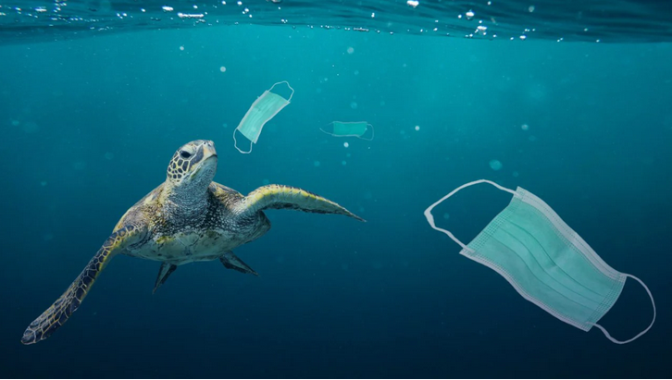
Thank you for your time.
Picture Citation: “Plastic Pollution: What happens to plastic after it enters the oceans?” Tech2, 2021. Accessed from https://www.firstpost.com/tech/science/plastic-pollution-what-happens-to-the-plastic-after-it-enters-the-ocean-9390831.html

